Slide 1
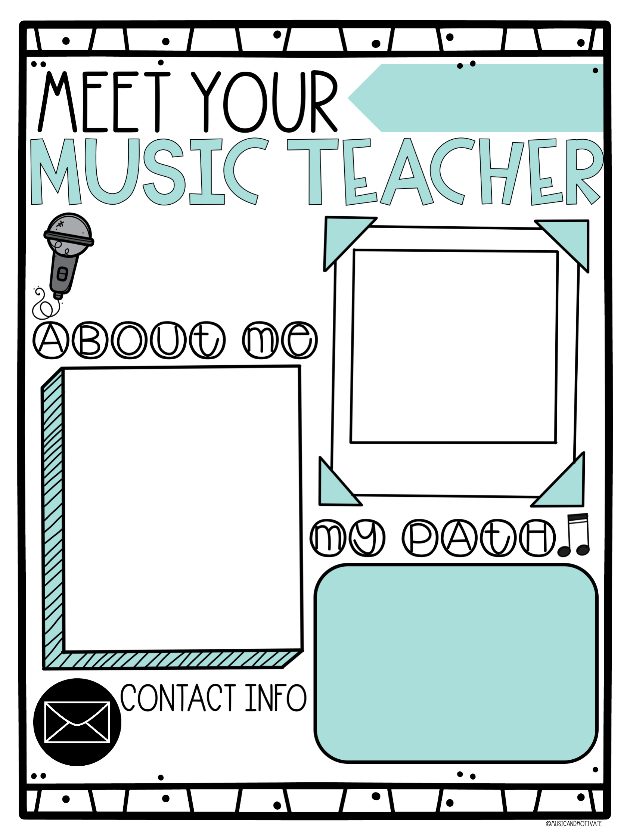
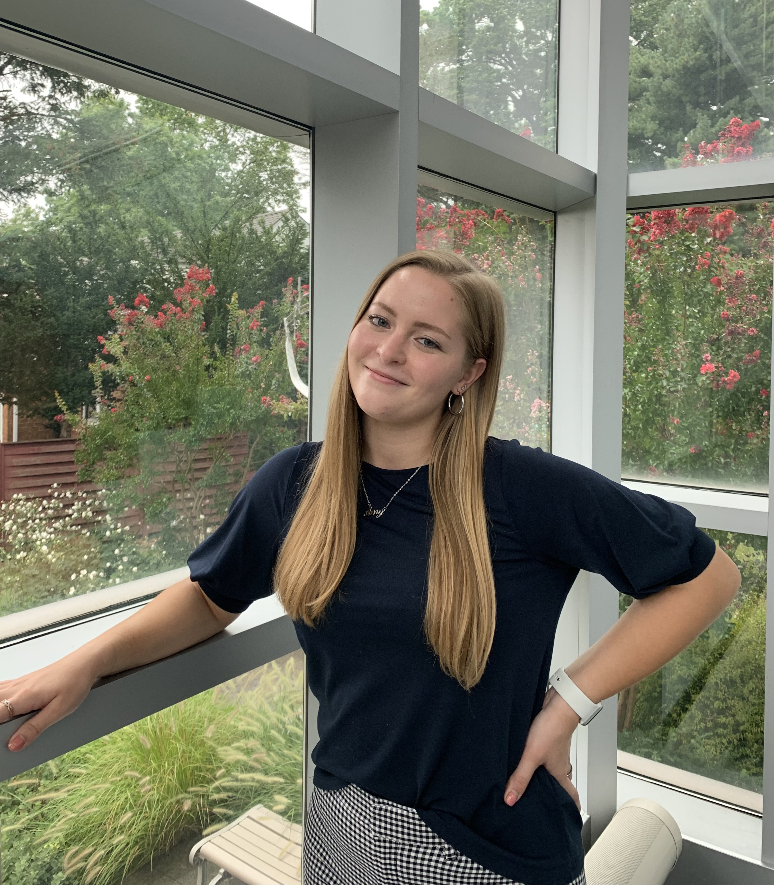
2024-25
School Year
Each individual is like a single note, together we make a masterpiece!
Insert a picture here!
My name is Amy Dabreau. I will be going into my 3rd year teaching Music at Elms Elementary School. When I am not teaching Music or doing something musical, I like to walk at the beach, try new coffee shops & restaurants, and spend time with family, friends, and my dog. Fun fact: I have an identical twin sister.
I am looking forward to another great year of making Music with your students!
- Ms. Dabreau :)
Ms. Dabreau
I have received my Bachelor’s of Science in Music Education from Hofstra University. I specialized in Voice but took classes to explore the many different instruments. While I was there, I was a part of both the Chorale and Chamber choir. I also participated and held leadership roles in two A Cappella groups.
School Phone: 732-833-4680
adabreau@jacksonsd.org

